Slide 1
Project 1
Timothy Yu
10/20/21

Slide 2
Feature: Menu Options for UX
Goal: Be able to do everything within UiPath instead of having to use external SQL queries

Slide 3
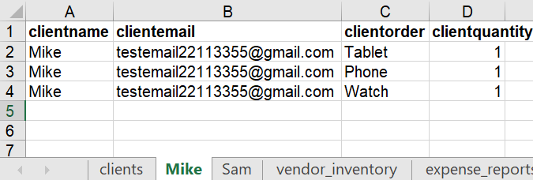
Client Shopping List Input Format
Name
Email
Item
Quantity
Clients must have their own labeled excel sheet with:
their name,
email,
the item they want,
and the quantity

Slide 4
Live Demo
Tables are already created:
Client database already populated with 3 customers (Alex, John, Shawn)
What we’re going to do:
We’re going to add two clients (Mike, Sam)
Scrape pega and three shopping vendors
And run the expense reports for all clients

Slide 5
Customers
Red Items aren’t available from Pega or the three vendors
Alex
Ipoh Coffee
Chai
Green Tea
John
Beef
Veggie Spread
Sushi
Shawn
Paperclip
Eraser
Pen
Mike
Tablet
Phone
Watch
Sam
Car
Bike
Bicycle
Alex:
Wants beverages
John:
Wants food
Shawn:
Wants stationery
Mike:
Wants technology
Shawn:
Wants vehicles

Slide 6
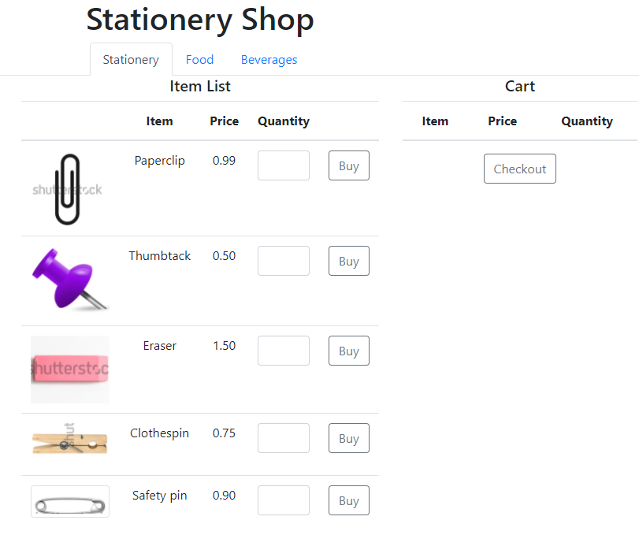
Four vendors
Stationery shop
Food shop
Beverages shop
Pega
Note:
Shopping cart per client is calculated in UiPath to increase automation speed

Slide 7
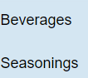

Pega and Vendors (Data Scraping Activity)
Table
Table
Vendor
Inventory
Pega
…
…
…
Stationery shop
…
…
…
Food Shop
…
…
…
Beverage Shop
…
…
…
HTML/CSS/JS
HTML/CSS/JS
Vendor
Offerings

Slide 8
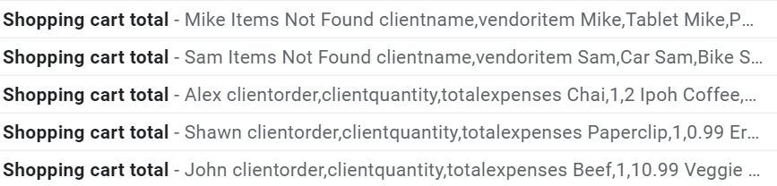
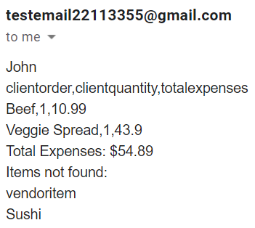
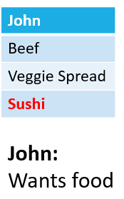
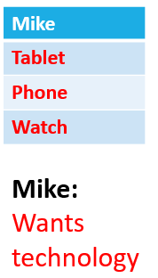
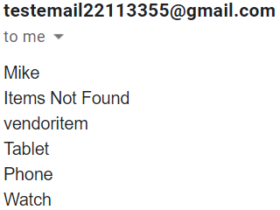
Feature: Email Clients Total Expenses and Items Not Found

Slide 9
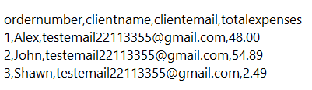
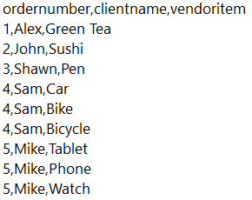
Feature: Client Expense Report and Items Not Found
Expense Report
Items Not Found
No Tea, Sushi, or Pen
From the combination of vendors
Clients that had entire carts of unavailable items are not added to the expense report
No Technology or Vehicle Vendor
for Mike and Sam

Slide 10
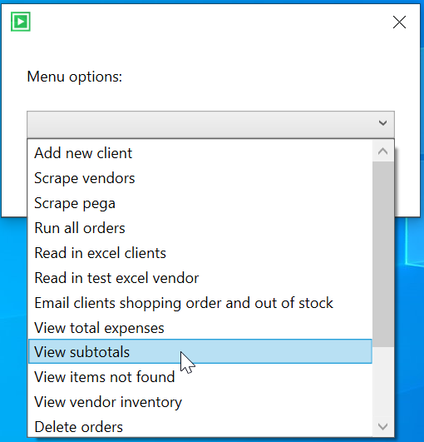
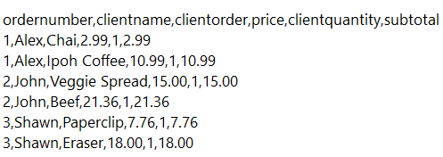
Feature: View Subtotals
SQL
"select orders.ordernumber,clients.clientname, shoppinglist.clientorder,shoppingexpense.price,shoppinglist.clientquantity,shoppingexpense.subtotal
from orders
inner join clients on orders.clientid = clients.clientid
inner join shoppingexpense on shoppingexpense.ordernumber = orders.ordernumber
inner join shoppinglist on shoppinglist.itemID = shoppingexpense.itemID
order by ordernumber asc;"
UiPath Output

Slide 11
Feature: Menu Options for UX
Goal: Be able to do everything within UiPath instead of having to use external SQL queries

Slide 12
Other Features
Dropdown selector menu
Delete clients, orders, vendor inventory
View client info, orders, totals, subtotals, items not found
Read in excel clients to database
Read in test excel vendor to database
Error handling
For adding clients (input values check)
For views (empty query datatable check)
Dedicated sequence to handle an edge case to send out of stock emails to clients whose entire order was out of stock/unavailable.
Goal: Be able to do everything within UiPath instead of having to use external SQL queries

Slide 13
References
Website and website repository:
https://210927-reston-uipath.github.io/Yu_T-P1-website/
https://github.com/210927-Reston-UiPath/Yu_T-P1-website/settings/pages
Website uses Bootstrap for template and layout:
https://getbootstrap.com/
Website references the following repository for html/css/js code for adding items to cart:
https://github.com/210927-Reston-UiPath/TindahanNiAlingNena
Website uses shutterstock for royalty-free stock images:
https://www.shutterstock.com/

